Slide 1

Overcoming the Stigma of Selling
Presented by
Danny Wood
Danny Wood Enterprises, LLC

Slide 2
The Success Triangle
Confidence
Guts
Self-esteem
Personal Presence
Belief
Attitude
SUCCESS
Behavior
Technique
Strategy Goals Plans Action
Tactics: What you say when you open your mouth
(c) 2014 Sandler Systems, Inc. All rights reserved.
Danny Wood Enterprises· 301 Route 17, Suite 800 · Rutherford, NJ 07070
Tel: 201-842-0055 · dwood@sandler.com · www.dwood.sandler.com

Slide 3
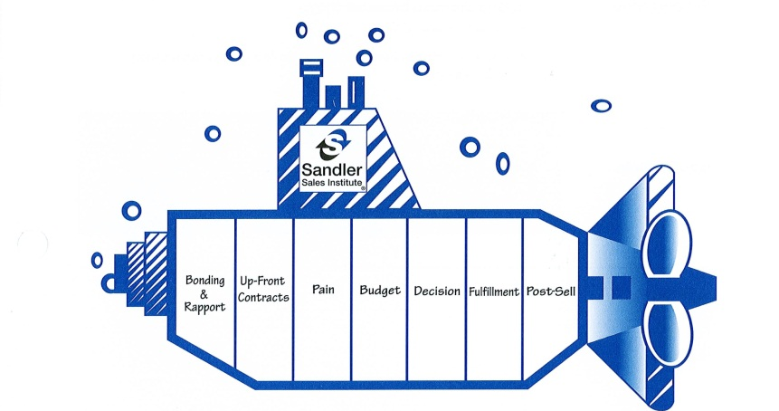
The Sandler Selling System
(c) 2014 Sandler Systems, Inc. All rights reserved.
Danny Wood Enterprises· 301 Route 17, Suite 800 · Rutherford, NJ 07070
Tel: 201-842-0055 · dwood@sandler.com · www.dwood.sandler.com

Slide 4
Bonding & Rapport
Communication Skills
Increasing comfort & trust
Mirroring behavior style
Selling psychology
(c) 2014 Sandler Systems, Inc. All rights reserved.
Danny Wood Enterprises· 301 Route 17, Suite 800 · Rutherford, NJ 07070
Tel: 201-842-0055 · dwood@sandler.com · www.dwood.sandler.com

Slide 5
Up Front Contracts
Setting clear agendas
Creating mutual comfort
Mutual agreement on next step
(c) 2014 Sandler Systems, Inc. All rights reserved.
Danny Wood Enterprises· 301 Route 17, Suite 800 · Rutherford, NJ 07070
Tel: 201-842-0055 · dwood@sandler.com · www.dwood.sandler.com

Slide 6
Pain
Finding the real issues
Cost of the issues (ROI)
Determining the impact of those issues, technically & emotionally
(c) 2014 Sandler Systems, Inc. All rights reserved.
Danny Wood Enterprises· 301 Route 17, Suite 800 · Rutherford, NJ 07070
Tel: 201-842-0055 · dwood@sandler.com · www.dwood.sandler.com

Slide 7
Budget
Is there a commitment to really change?
Willing and able to invest money
(c) 2014 Sandler Systems, Inc. All rights reserved.
Danny Wood Enterprises· 301 Route 17, Suite 800 · Rutherford, NJ 07070
Tel: 201-842-0055 · dwood@sandler.com · www.dwood.sandler.com

Slide 8
Decision
A mutual process for making decisions
Buying influences and modes
Determining how and when decisions are made
(c) 2014 Sandler Systems, Inc. All rights reserved.
Danny Wood Enterprises· 301 Route 17, Suite 800 · Rutherford, NJ 07070
Tel: 201-842-0055 · dwood@sandler.com · www.dwood.sandler.com

Slide 9
Fulfillment
Present only their pains
“Proof” of ROI
Agreement to move forward or not
(c) 2014 Sandler Systems, Inc. All rights reserved.
Danny Wood Enterprises· 301 Route 17, Suite 800 · Rutherford, NJ 07070
Tel: 201-842-0055 · dwood@sandler.com · www.dwood.sandler.com

Slide 10
Post-Sell
No buyer’s remorse
Referral process
See the future
Transfer to others
(c) 2014 Sandler Systems, Inc. All rights reserved.
Danny Wood Enterprises· 301 Route 17, Suite 800 · Rutherford, NJ 07070
Tel: 201-842-0055 · dwood@sandler.com · www.dwood.sandler.com

Slide 11
Thank You for Attending
Please like me on Facebook at Facebook.com/DannyWoodSandler and follow me on Twitter @SandlerDWood
(c) 2014 Sandler Systems, Inc. All rights reserved.
Danny Wood Enterprises· 301 Route 17, Suite 800 · Rutherford, NJ 07070
Tel: 201-842-0055 · dwood@sandler.com · www.dwood.sandler.com

