Slide 1

MIT MINI-CONFERENCE
The Crisis of Long Term Unemployment: What Can be Done?
Joseph Carbone
President & CEO, The WorkPlace
May 6, 2014

Slide 2
Addressing Post-Recession
Workforce Challenges
May 2010 received notice regarding Connecticut Exhaustees.
Set out to learn how long-term unemployment had changed from prior recessions and what new remedies would be required?
  Began roundtables with long-term unemployed.
  Created “Blue Ribbon” Committee to help explore new realities.
Spent a year on local speaking circuit educating the community and future partners that the long-term unemployed are experiencing an Economic Hurricane.
Developed concept for a program with new services that are remedies to the specific challenges we discovered.
Created a social enterprise investment opportunity that would become the catalyst for a larger project.
2

Slide 3
CHALLENGE
The marketplace today is more competitive than ever.
Long-term unemployment has the ability to erode self-confidence and self-esteem. These challenges must be addressed for this population to compete for employment.
Platform to Employment
Incorporates a for-profit training provider “Career Team” to deliver a proven curriculum of self-assessment, change management, effective communication and successful job search strategies.
During a 5-week preparatory program P2E participants take action and fully realize their personal and professional potential. They develop new strategies for solving problems and create a positive change in themselves.
3

Slide 4
CHALLENGE
Emotional issues associated with long-term unemployment impact the individual and their family and present a constant barrier to employment. This is our current reality.
Loss of self-respect: Nearly four-in-ten (38%) long-term unemployed report they have lost some self-respect while out of work, compared with 29% who were jobless for shorter periods of time. The long-term unemployed also are significantly more likely to say they sought professional help for depression or other emotional issues while out of work (24% vs. 10% for those unemployed less than three months).
Addressing an individuals ability to compete is the centerpiece of what we do. It is not an altruistic endeavor.
Platform to Employment
Behavioral Health Consultants LLC. provides counseling and behavioral health services to the participants and their immediate families to manage stress, address depression and build confidence.
Source: “The Impact of Long-term Unemployment Lost Income, Lost Friends—and Loss of Self-respect” Pew Research Center
4

Slide 5
CHALLENGE
We are in a “Buyers Market”. Employers are in a position to select from a bounty of highly skilled, well-educated and most cost effective applicants.
Employers face significant challenges to keep labor cost low while increasing productivity. Cautious employers will hire temps first and leverage “just-in-time” employment practices.
From 2009 to 2013, nearly 1 in 5(18%) jobs added in the U.S. were temporary positions.
Platform to Employment
P2E is not a training program. We examine work histories and match employer needs with reliable candidates.
P2E subsidizes a work experience program and pays for the participant’s first eight weeks on the job.
Employers have a risk-free opportunity to evaluate job candidates and see if a good match exists.
Source: Economic Modeling Specialists, Intl., A Career Builder company
5

Slide 6
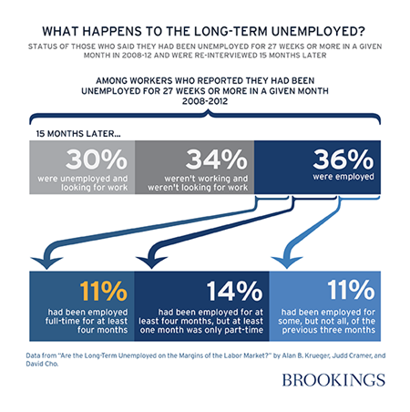
What Happens To The Long-Term Unemployed?
Status Of Those Who Said They Had Been Unemployed For 27 Weeks Or More In A Given Month In 2008-12 And Were Re-Interviewed 15 Months Later
6

Slide 7



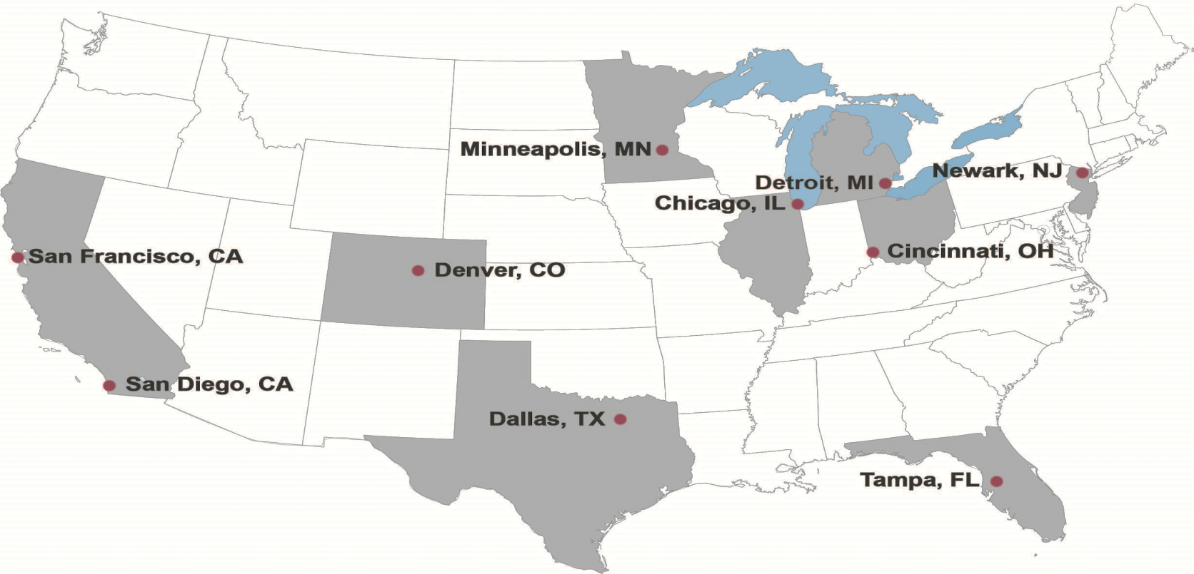
CONNECTICUT COHORTS 2011 - 2013
 | # of Participants | # Dropped from Program | # Completed | # Placed In Work Experience | % Placed In Work Experience | Referred to Training or In Job Search | # Hired After Work Experience | % Hired After Work Experience
Total | 164 | 14 | 150 | 122 | 81% | 28 | 108 | 88%
NATIONAL REPLICATION: (DALLAS, CINCINNATI, SAN DIEGO, CHICAGO, DENVER, MINNEAPOLIS, NEWARK)
Total | 162 | 34 | 128 | 101 | 79% | 27 | 92 | 91%
Detroit & San Francisco and Tampa are in progress
7

Slide 8
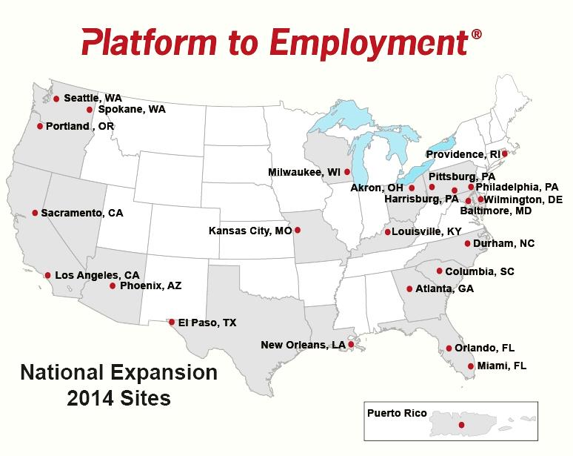
TARGET EXPANSION
Evaluating Partnership Opportunities
Approximately 180 cohorts over 3 years
3,200 People Served
TARGET ACTIVITY
25 Sites
5 Cohorts Per Site
4 More Cohorts In Original Sites
8

Slide 9
Our Moral Challenge
Bringing the long-term unemployed to a platform of readiness, emotionally and professionally, is an essential duty of the American Workforce System.
The ways and means must be relevant to the needs of the unemployed to prepare them for work and convince employers they are worth keeping.
The long-term unemployed are slipping further away from ever having a chance for employment.
Society will give us a “pass” if we chose to do nothing. This represents our moral challenge.
9

Slide 10



THANK YOU
Joseph Carbone
President & CEO
The WorkPlace
www.platformtoemployment.com

