Slide 1
Leadership Lessons from the Transition Zone
Neighbors helping Neighbors
3 Years and Counting
January 2014

Slide 2
Your Speaker
Terrence “Terry” Seamon
Leadership & Organization Development consultant
Author of To Your Success, Lead the Way, and Change for the Better
Co-Moderator of the St. Matthias Employment Ministry in Somerset, NJ
>30 years in Training & Organization Development
Follow me on Twitter = @tseamon
Connect on LinkedIn
Join me on facebook: https://www.facebook.com/FacilitationSolutions

Slide 3
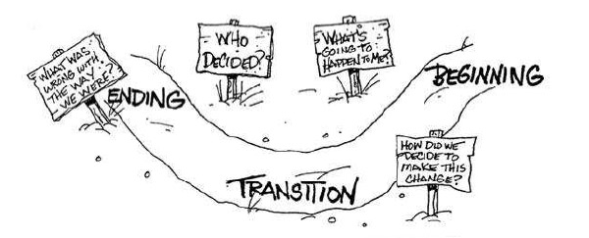
The Transition Zone

Slide 4
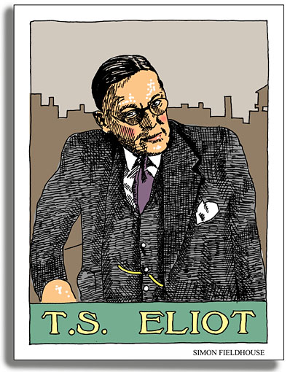
T. S. Eliot
"Everyone gets the experience; some get the lesson." - T.S. Eliot

Slide 5

It’s a new world

Slide 6

Leadership lesson

Slide 7
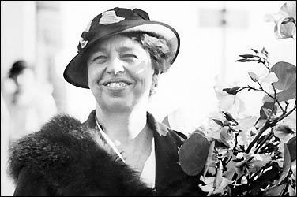
Eleanor Roosevelt on Overcoming Fear
“You gain strength, courage and confidence by every experience in which you really stop to look fear in the face. You are able to say to yourself, 'I have lived through this horror. I can take the next thing that comes along.' You must do the thing you think you cannot do.”

Slide 8
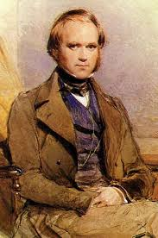
Charles Darwin
It isn’t the strongest or the most intelligent that survives, but the one who is most adaptable to change.

Slide 9
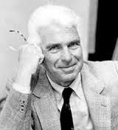
Warren Bennis
Leadership is the capacity to turn vision into reality.

Slide 10
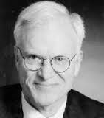
William Bridges
No change without transition.

Slide 11
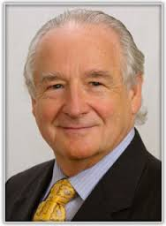
Roland Sullivan
"The leaders that have a successful way to transform their organizations will win the game."

Slide 12
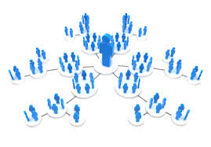
Network constantly

Slide 13
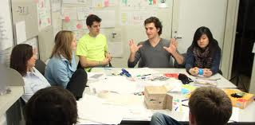
Join professional groups

Slide 14

Volunteer

Slide 15

Conduct informational interviews

Slide 16
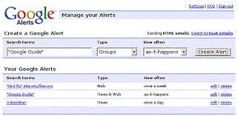
Create multiple alerts

Slide 17

Never stop learning

Slide 18
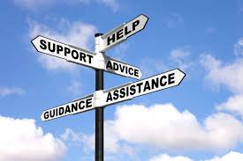
Find a mentor (or several) / Be a mentor

Slide 19

Design your brand

Slide 20

Tony Robbins Ultimate Success Formula
Know what you want – In clarity of purpose is power. Where your focus goes, so goes your energy and imagination.
Take action – Do it now! Take massive, consistent action without let up. Be relentless.
Notice your progress – Ask yourself, Are my actions getting me closer to my goal?
Make adjustments – If your actions are not getting you closer to your goals, change your approach. And keep changing (and learning) as much as you have to until you reach your target.

Slide 21
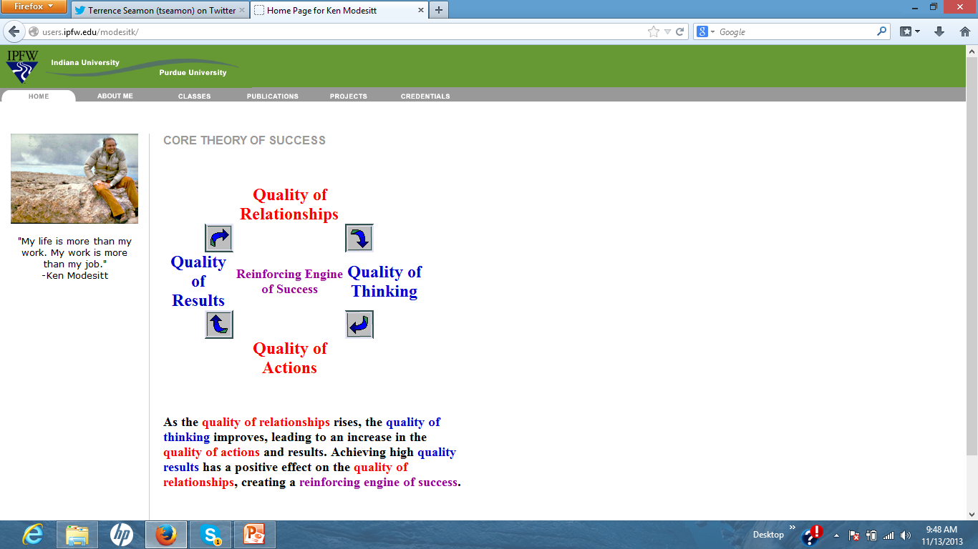
Have an Engine of Success

Slide 22
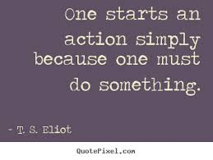
T. S. Eliot again

